Slide 1
Applying to a Conservatoire
Last updated July 2023

Slide 2
What’s a conservatoire?
Conservatoires provide performance-based higher education, including music, drama, screen and production courses – both at undergraduate and postgraduate levels.
UCAS offers an application route to nine UK conservatoires – each has its own strengths and specialisms, so its important you do your research to find the right fit for you:
Royal Birmingham Conservatoire
LAMDA
Leeds Conservatoire
Royal Academy of Music
Royal College of Music
Royal Conservatoire of Scotland
Royal Northern College of Music
Royal Welsh College of Music and Drama
Trinity Laban Conservatoire of Music and Dance

Slide 3
What’s the difference to university?
Facilities
Conservatoires tend to be smaller institutions which are focused on specific areas of study; such as music, dance and drama. They will, therefore, have specialist teaching and facilities dedicated to these areas.
Specialist focus
Universities tend to be much larger and will often offer a broad range of courses which could include anything from maths and engineering to art, history and music.
Practical study is the main focus
Both conservatoires and universities offer degree-level qualifications, however at a university practical study is typically an element of the course, whereas at a conservatoire it’s the main focus, and at the heart of what students do.
Course structures
The year is broken down into a block of academic weeks, followed by a block of performance weeks. Performances and workshops are mostly held in the evenings and at weekends meaning graduates are accustomed to expectations of the industry they are going to work in.
Teaching staff are working professionals
Professional musicians teach at conservatoires as part of their portfolios, and many teach at more than one conservatoire. There is a strong emphasis on one-to-one tuition, alongside group work and performances.
Security marking: PUBLIC
25 July 2023
| 3

Slide 4
Making an application

Slide 5
Start your research
Register with the UCAS Hub to:
explore careers, subjects, places, and apprenticeships
find and favourite courses
search for open days and online events
speak to those in the know using Unibuddy
speak to career, higher education, and application specialists by attending the Hub lives.
See ucas.com/conservatoires for more advice and guidance.

Slide 6
When to apply for 2024 entry
12 July 2023
Students can start submitting applications for courses starting in 2024
2 October 2023
UCAS deadline for music applications
31 January 2024
UCAS deadline for dance, drama, or musical theatre course applications.
Security marking: PUBLIC
25 July 2023
| 6

Slide 7
Starting an application
To start an application you need to register with ucas.com.
You can register at any time.
From 12 July 2023 you’ll be able to start a conservatoire application for 2024 entry.
Courses are listed in our search tool.
Use the ‘conservatoire filter’ to see conservatoire courses only.

Slide 8
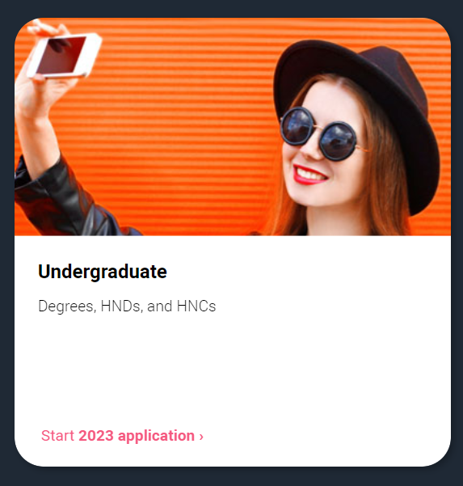
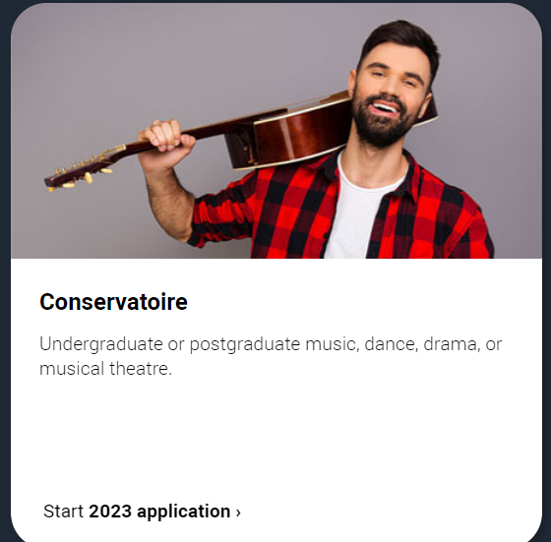
Key facts
You can add up to 6 choices for a conservatoire application.
Applying costs £27.50 for 6 choices.
Apply by the relevant equal consideration date for your specialist area.
It’s likely you’ll need to attend an audition or interview.
There’s usually a fee for this which UCAS collects during the application. However, in some cases you’ll need to pay the conservatoire directly.

Slide 9
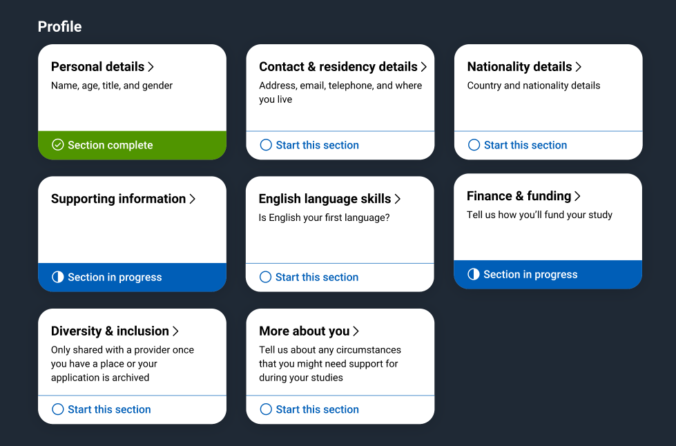
Making an application
Sections to be completed:
Personal details
Contact and residency details
Education
Nationality details
English language skills
Supporting information
Finance and funding
Diversity & inclusion (for students with a UK home address)
More about you
Personal statement
References
Choices – make up to six
Security marking: PUBLIC
25 July 2023
| 9

Slide 10
Getting references
You'll need to provide details of two referees for each conservatoire you apply to:
One to comment on your academic ability
One to comment on your practical ability
Enter your referee details into the reference section of the application.
We’ll email a request with instructions on what they need to do.
You’ll be emailed when they provide a reference so you can submit your application.
If you’re going to miss the application deadline, submit your application without the reference and confirm it’s outstanding by ticking the relevant option.
You can then download the offline reference forms and send these to your references separately.

Slide 11
Personal statement
The only section you have full control over
Your chance to market yourself as an individual
UCAS’ similarity detection service:
every personal statement is run through software to check for plagiarism.
The same for all of your choices
A maximum of 4,000 characters, or 47 lines
A minimum of 1,000 characters
For more guidance visit: ucas.com/conservatoires
There isn’t a spelling or grammar check
No formatting allowed
Security marking: PUBLIC
25 July 2023
| 11

Slide 12
What to write about
Why you’re applying – your ambitions and what interests you about the subject, conservatoires and higher education.
Your reasons for your choices – remember each conservatoire will be able to see the other conservatoires courses you've applied to.
What interests you about your chosen study area – whether that’s playing an instrument, acting, singing, conducting, stage design or another specialist area.
Your experience within your chosen specialist area – and any other activity related to the course(s) for which you’ve applied.
What makes you suitable – membership of national or international orchestras, choirs or chamber groups (such as NYO, EUYO or National Youth Theatre). Any other relevant skills and achievements gained from education, work or other activities.
Security marking: PUBLIC
25 July 2023
| 12

Slide 13
Conservatoire assessments
This could be an audition, interview, portfolio, or a recording.
You may have more than one audition/interview, depending on the conservatoire's audition policy, and the study type and course you choose:
Main specialism – one audition will be needed.
Joint main specialism – two auditions, one for each specialism, will be needed.
Secondary specialism – some conservatoires will audition on your main specialism only, whereas others will audition on both your main and secondary specialism.
Alternative main specialism – two auditions, one for each specialism, will be needed.
After an assessment the conservatoire will update your application with their decision.
UCAS will usually collect assessment fees with our application fee.

Slide 14
Tracking your application
Follow your application 24/7:
see your choices
keep personal information up to date
view and reply to your offers
You’ll receive one of three decisions from your choices:
unconditional offer
conditional offer
unsuccessful
Security marking: PUBLIC
25 July 2023
| 14

Slide 15
Decisions conservatoires can make
Audition pending (AP) – an invitation to audition, including the date, time and payment.
Guaranteed unconditional (GU) – a binding offer that confirms you’ve met the entry requirements.
Guaranteed conditional (GC) – an offer that’s guaranteed if you meet certain conditions – usually exam results.
Unsuccessful (REJ) – you haven’t been offered a place.
Reserve unconditional (VU) – you'll be in a pool of reserve applicants, if a suitable place becomes available on the course they may make you a guaranteed offer.
Reserve conditional (VC) – you'll be in a pool of reserve applicants, if a suitable place becomes available on the course they may make you a guaranteed offer subject to you meeting certain conditions.
Withdrawal (W) – this is recorded on your application if you withdraw from a particular conservatoire.

Slide 16
Replies to offers
You may only be able to accept one offer as a first choice, or you may be able to accept two offers and state your first and second choices. This depends on the type of offers you have.
If you accept a guaranteed unconditional (GU) offer, you cannot accept any other offer as a second choice, and must decline (D) all other offers.
If you accept a GU offer as your second choice and your first choice (VU or VC) is unsuccessful, you will have a place at your second choice.
If you accept a guaranteed conditional (GC) offer as your first choice, you'll also be expected to take up this place provided you meet the conditions. You cannot accept any other offer as a second choice. You must decline (D) all other offers.
If you accept a GC as your second choice, but you've met the conditions of the offer and your first choice (VU or VC) is unsuccessful, you will have a place at your second choice.
If you accept a reserve unconditional (VU) or a reserve conditional (VC) offer as your first choice, you may accept any type of offer as your second choice.
If your first choice is a reserve offer (VC1 or VU1) and the conservatoire changes it to a guaranteed offer (GC1 or GU1), then your second choice will automatically be rejected.
25 July 2023
| 16

Slide 17
Additional help
UCAS Customer Experience Centre:
0371 468 0 470
From outside the UK:
+44 330 3330 232
Monday to Friday, 08:30 – 18:00 (UK time)
Stay up to date online at:
facebook.com/ucasonline
twitter.com/UCAS_online
Security marking: PUBLIC
25 July 2023
| 17

Slide 18
Thank you
Security marking: PUBLIC
25 July 2023
| 18

